Slide 1


Lip Sync : End-to-End Sentence Level Lipreading
NATIONAL INSTITUTE OF TECHNOLOGY ANDHRA PRADESH
Using Deep Neural Network​
Minor Project
Introduction to Machine Learning(EE363)
by
Ritabrata Mandal​
521226​

Slide 2
Introduction
NATIONAL INSTITUTE OF TECHNOLOGY ANDHRA PRADESH
Decoding spoken language from visual mouth movements, a process known as lipreading, has traditionally involved two distinct stages: extracting visual features and predicting text. Recent advancements in the field have introduced end-to-end trainable models; however, these models have primarily focused on word classification rather than comprehending entire sentences. Motivated by the critical role of temporal context in lipreading, my project, Lip Sync, aims to implement the research paper titled "LipNet: End-to-End Sentence-Level Lipreading." This model is designed to map video frames to text at the sentence level, offering significant potential for enhancing lipreading accuracy and comprehension.

Slide 3


Methodology
NATIONAL INSTITUTE OF TECHNOLOGY ANDHRA PRADESH
Data Collection
Creating Data Pipeline
Designing Deep Neural Network
Setup Training Options
Train the Model
Make a Prediction
Test on a Video

Slide 4
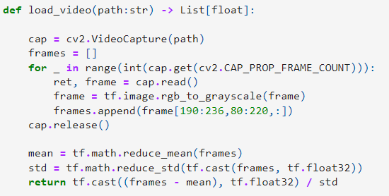
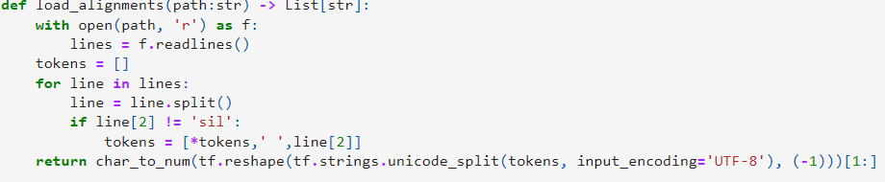
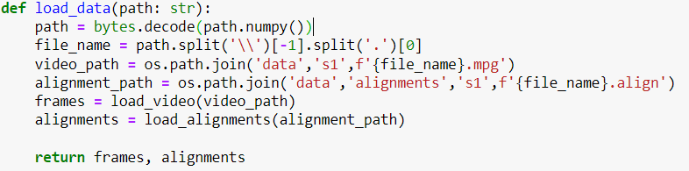
Data Collection
NATIONAL INSTITUTE OF TECHNOLOGY ANDHRA PRADESH
Loading a video from video set.
Append the mount region in array called frame.
Loading the alignments.
Loading vide and alignments in a function called load_data

Slide 5

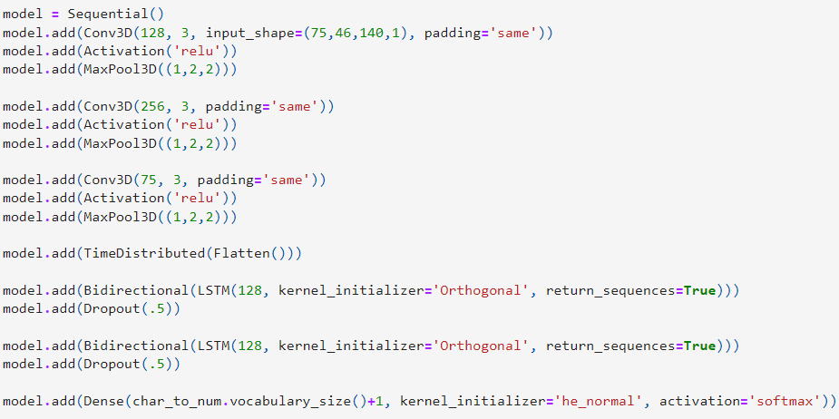
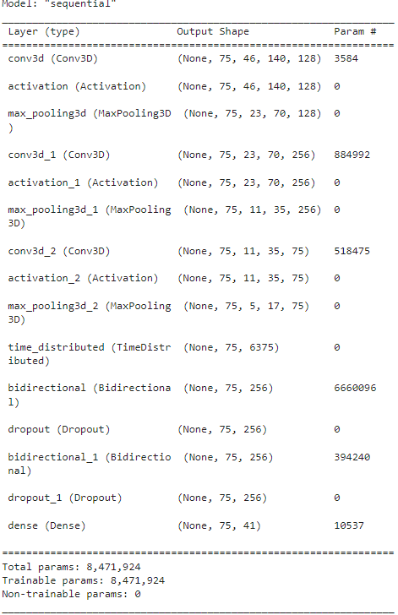
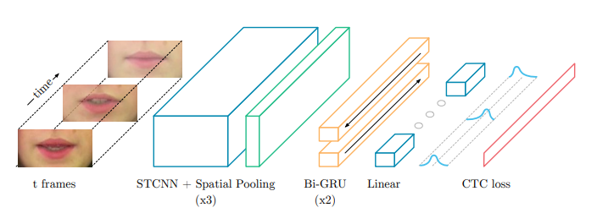
Designing Deep Neural Network
Used 3d convolution
LSTM

Slide 6
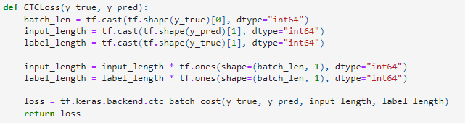
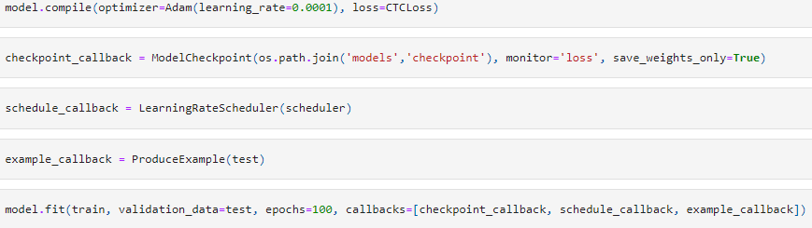
Setup Training Options and Training
Used Connectionlist temporal classification(CTC) loss.(The code from automatic speech recognition model.)
Compiling the model using adam optimizer with ctc loss.
Saving the checkpoints.
Optimizing the learning rate.
Finally fit the model.

Slide 7
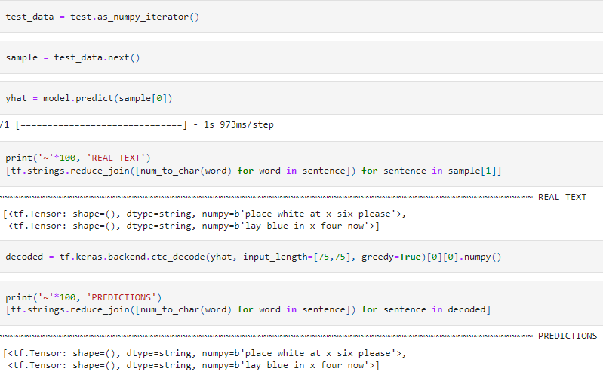
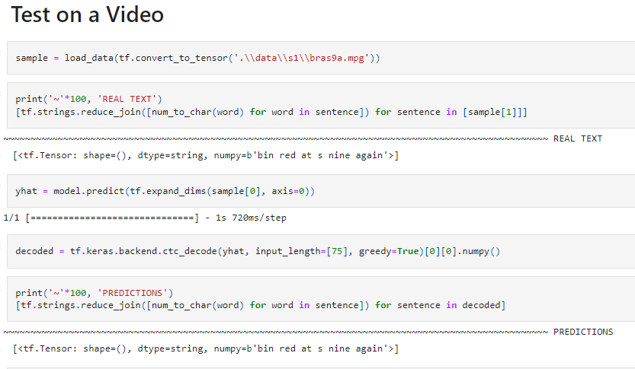
Make a Prediction & Test on a Video

Slide 8
References
https://doi.org/10.48550/arXiv.1611.01599
https://github.com/rizkiarm/LipNet/tree/master/lipnet
https://keras.io/examples/audio/ctc_asr/#model
https://doi.org/10.48550/arXiv.1611.01599

Slide 9
THANK YOU

